Slide 1
$_SESSION

Slide 2
Make a new directory called "session"
Copy the template website content to your session content.
Add the H2 title "Session work" to the index
Apply some basic styling to the site.

Slide 3
Super global variable
$_ = super global built into PHP
Accessible anywhere in your script (mostly)
Reserved names – no touching!

Slide 4
$_SESSION
Server side – more secure
Effectively a bucket for what we want to store
Declare sub variables in the bucket
Access them anywhere – Mr. Hacker man no touchy!

Slide 5
On each page... not file!
session_start();
This is ESSENTIAL, cannot be omitted or your code WILL NOT WORK if trying to access it.
Opens our connection to the session

Slide 6
Edit your "template"
In the index.php
After "<?php
The next line should be:
  session_start()
Anywhere we need to access session, we need this line ALWAYS

Slide 7
Index.php
Add a form
  Method = 'post' action = ''
Input text name='message'
Submit button
Copy it from your other page.

Slide 8
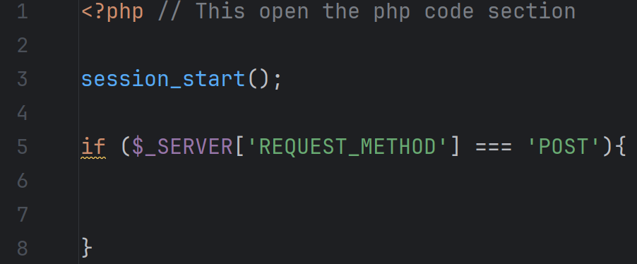
Top of index.php

Slide 9
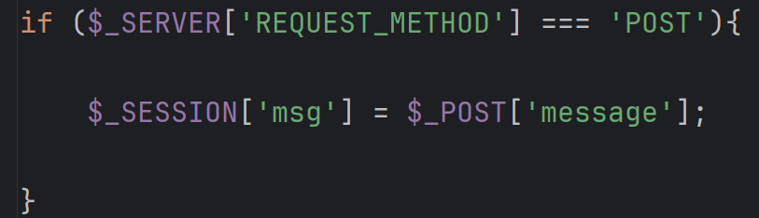
Create and assign a session value

Slide 10
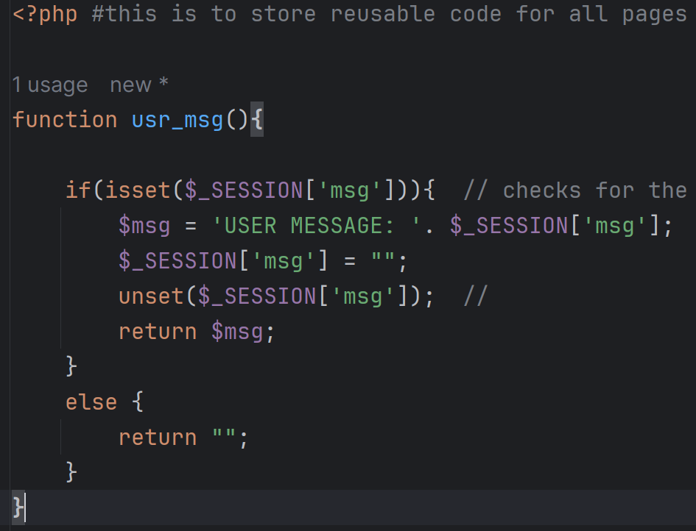
assets / common.php

Slide 11
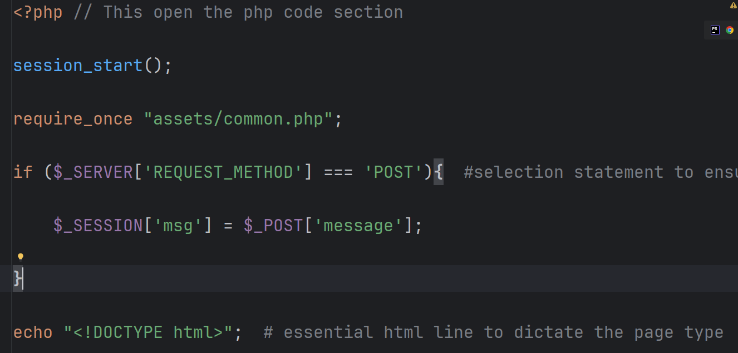
Back to index.php

